Slide 1
Attachment Redesign
UrinDX Attachment Module

Slide 2
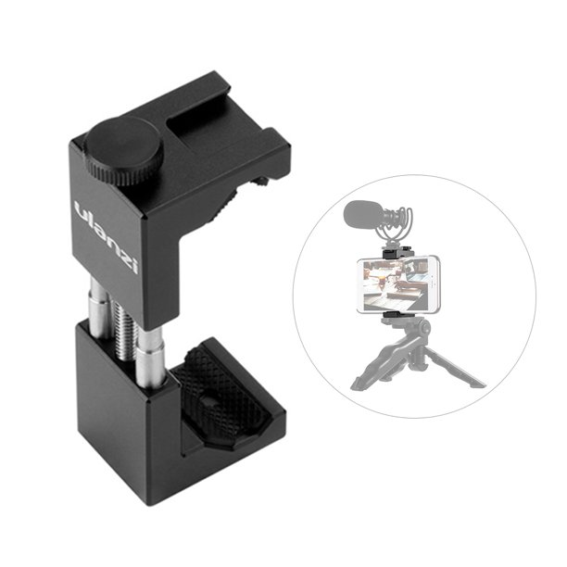
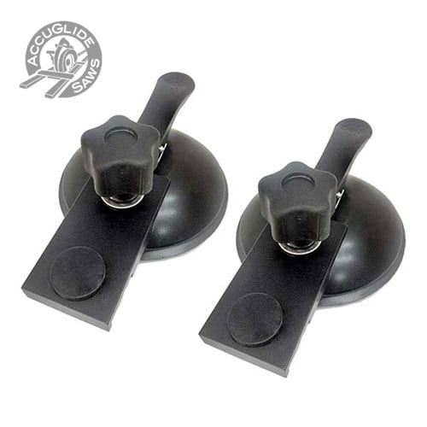
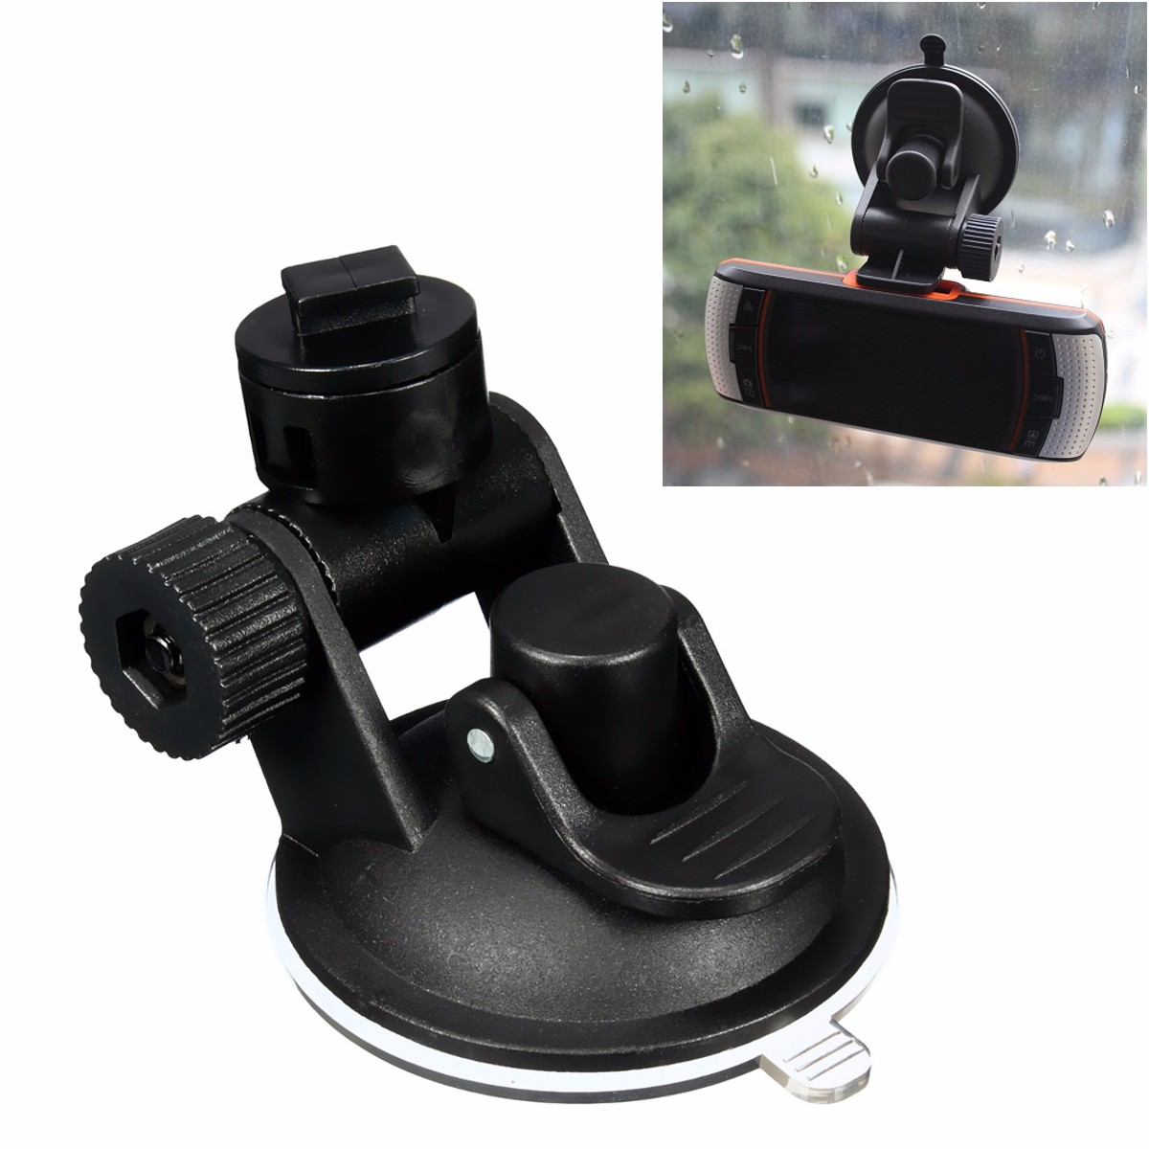
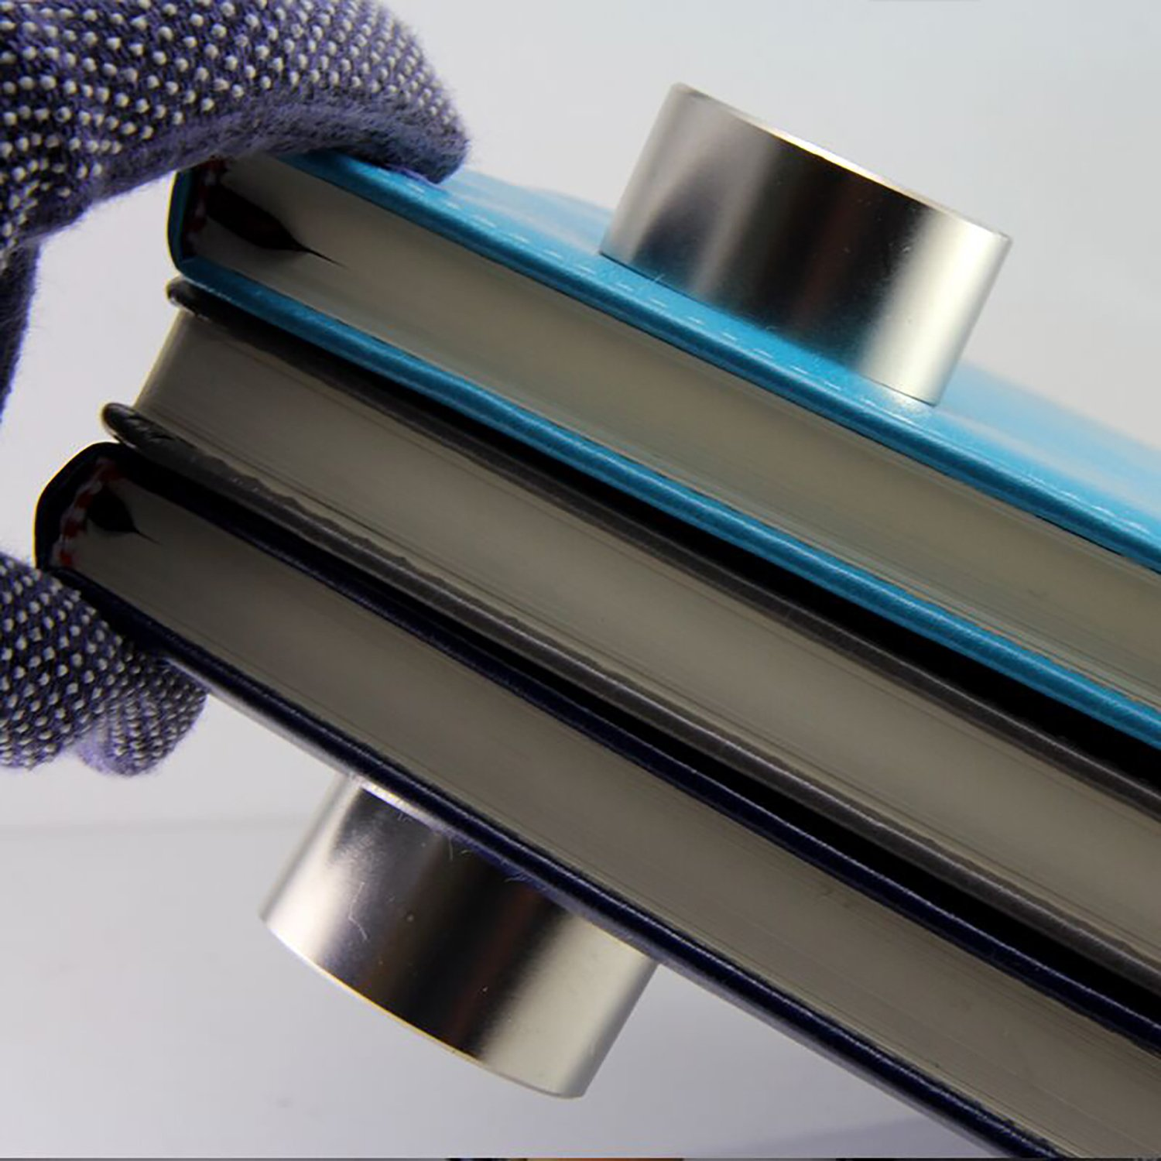
Proposals
Mechanical Clamp
Suction Cup
Magnet
*Must hold 150g

Slide 3
Design Iterations

Slide 4
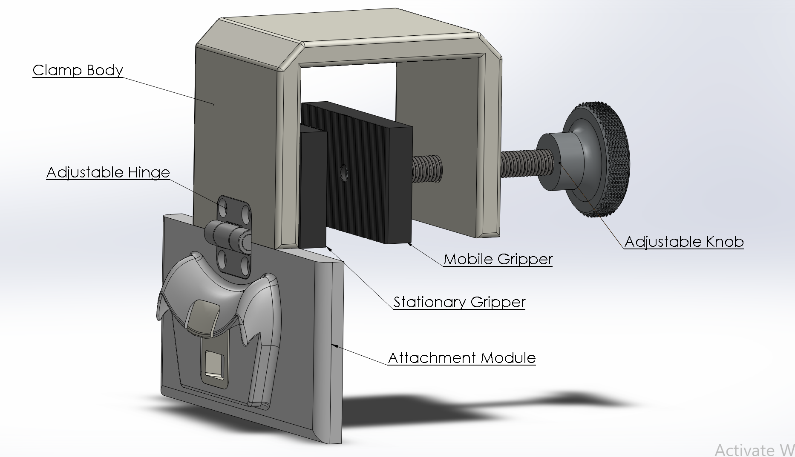
Mechanical Clamp V1

Slide 5
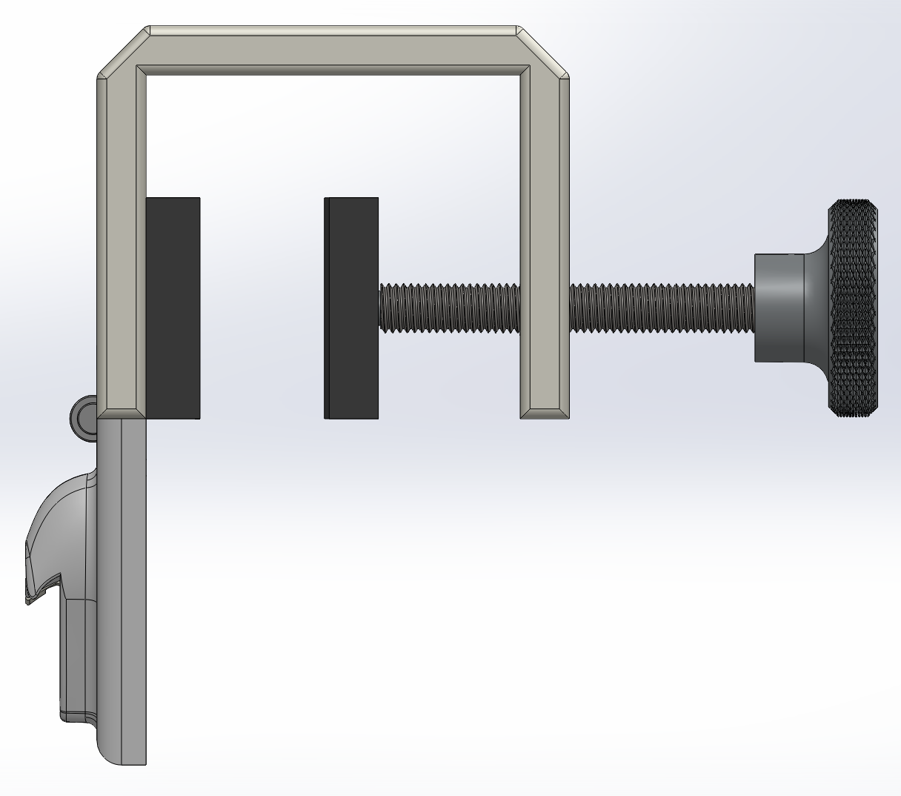
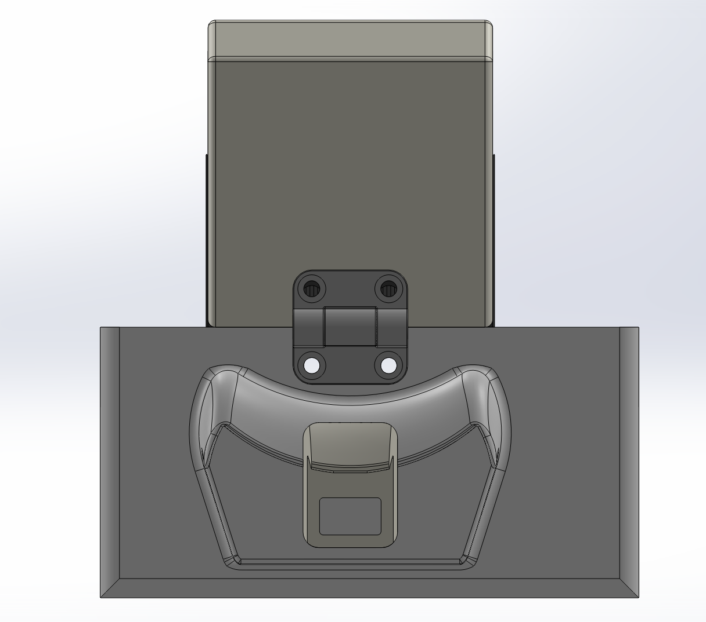

Slide 6
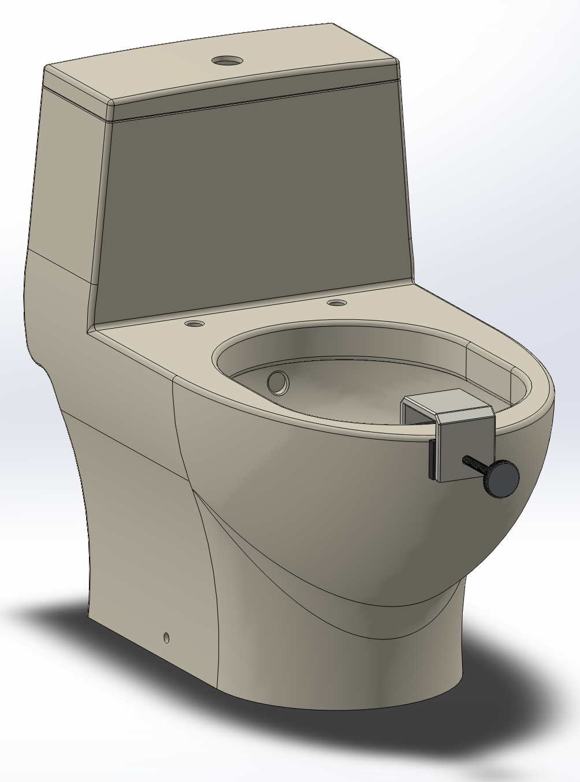
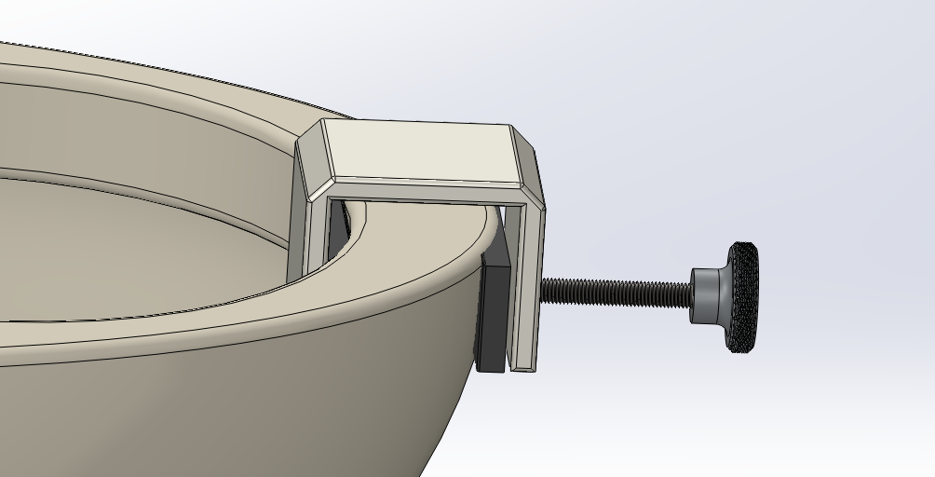

Slide 7
Bill of Materials
Item | Quantity | Unit Cost
Hinge | 1 | $12.22
Knob | 1 | $9.44
PMC-790 | 1 | $2.38
VytaFlex 20 | 1 | $3.34
Total |  | $27.38

Slide 8
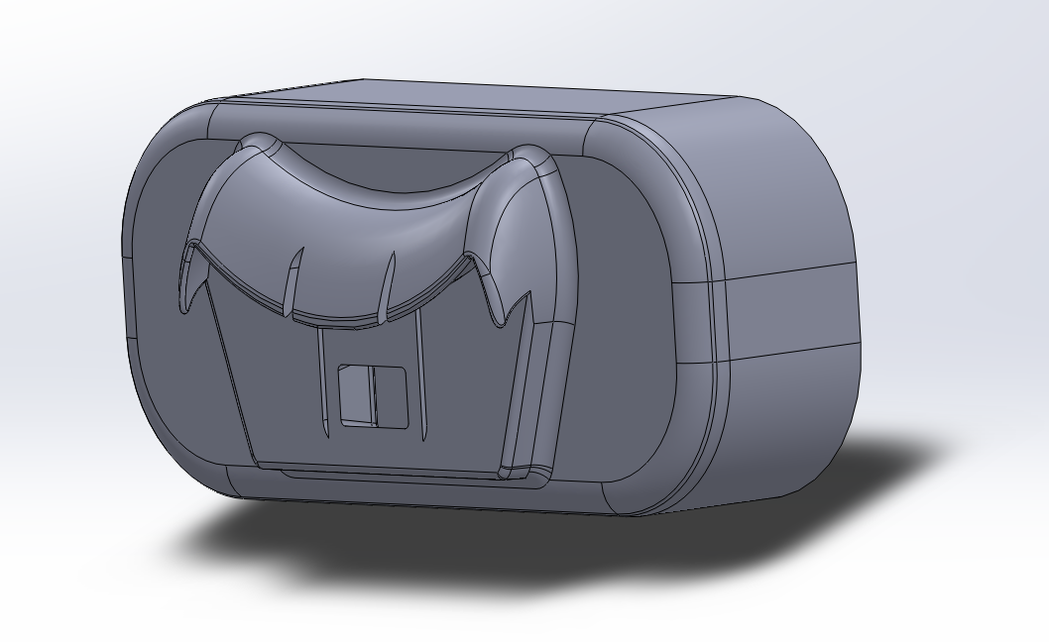
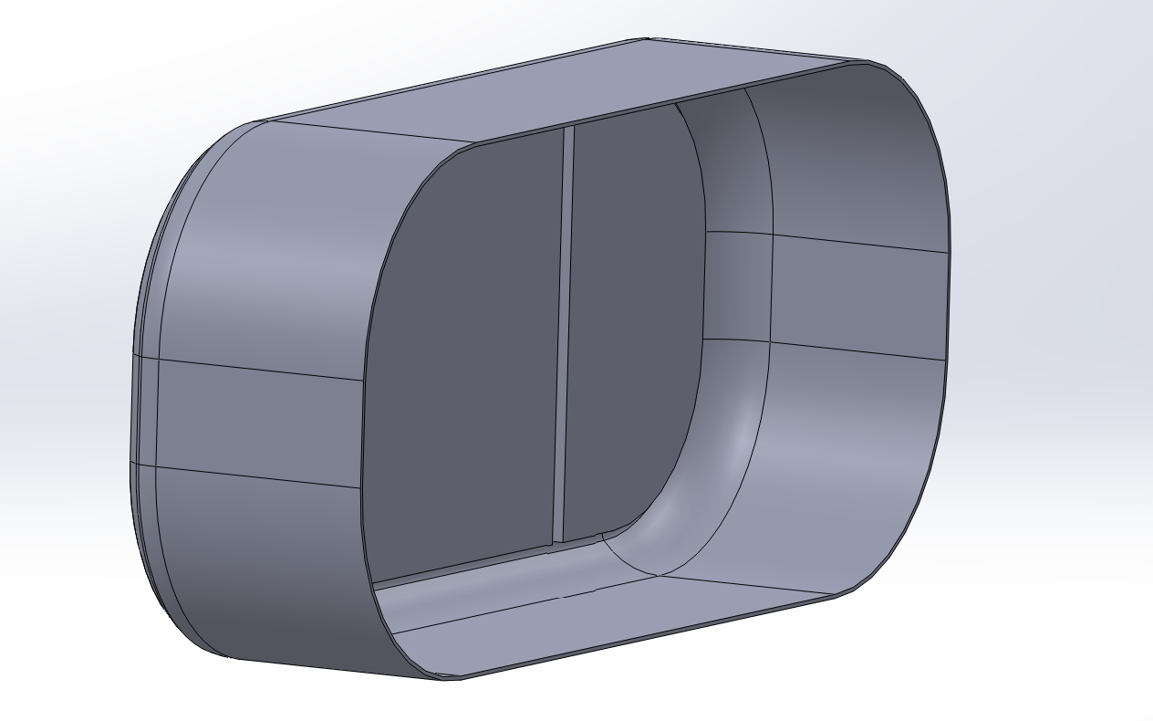
Suction Cup (Inside of Bowl)

Slide 9
Bill of Materials
Item | Quantity | Unit Cost
VytaFlex 20 | 1 | $1.31
Total |  | $1.31

Slide 10
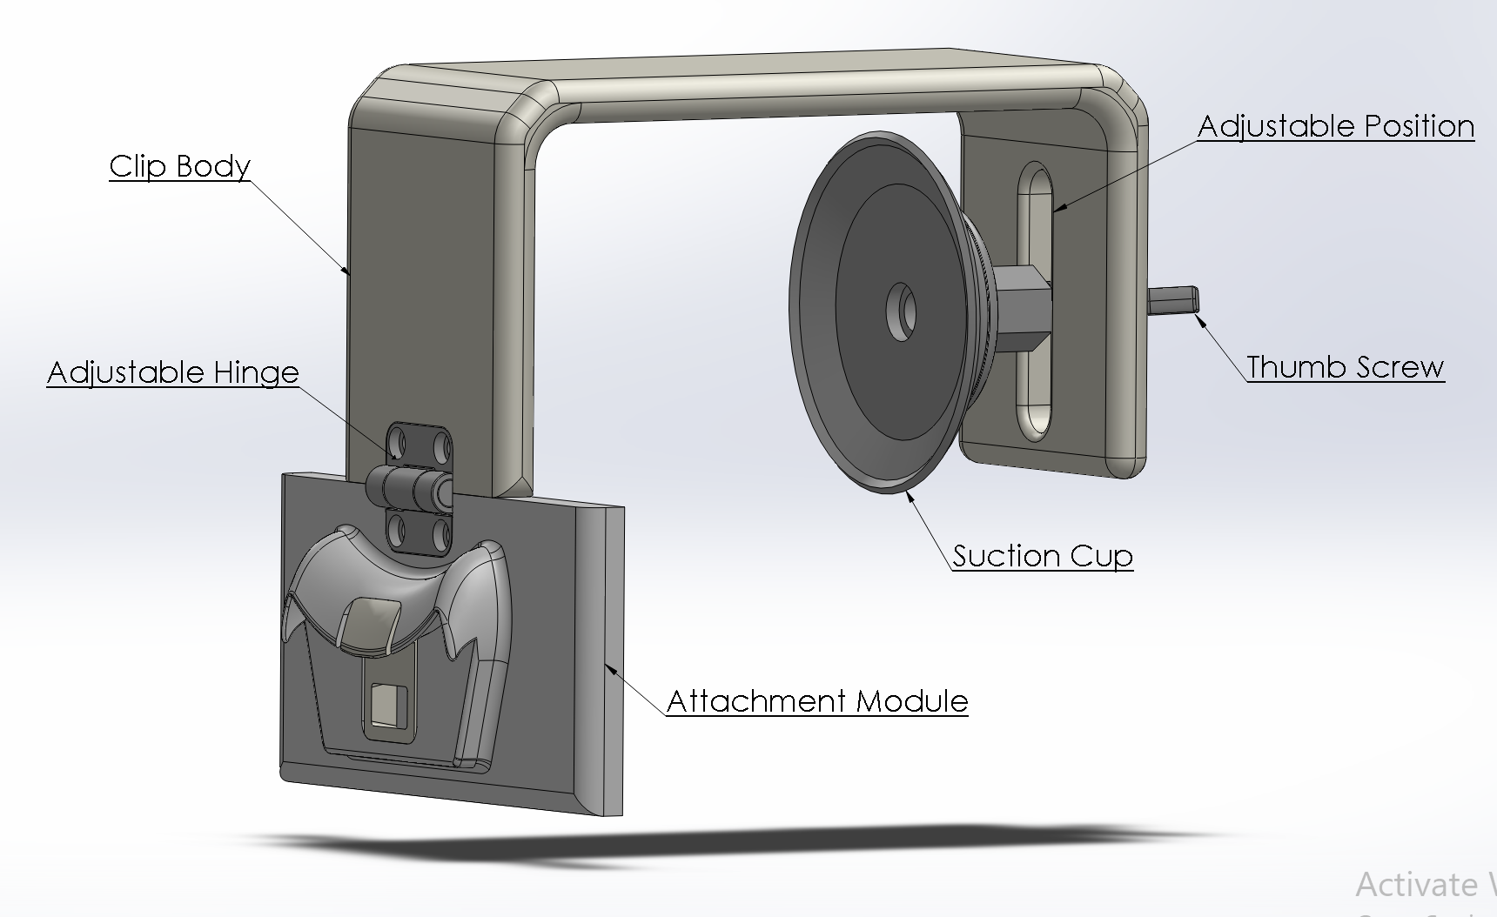
Suction Cup (Outside of Bowl) V1

Slide 11
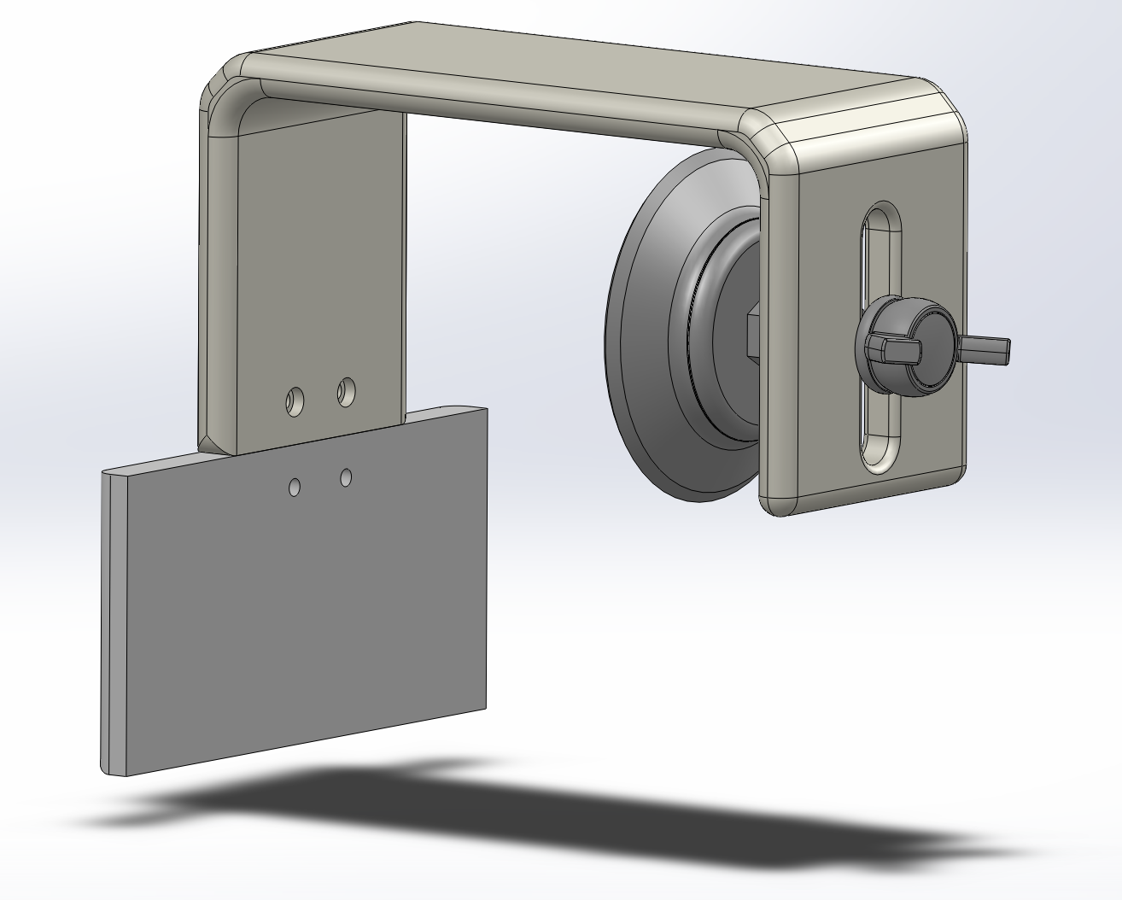
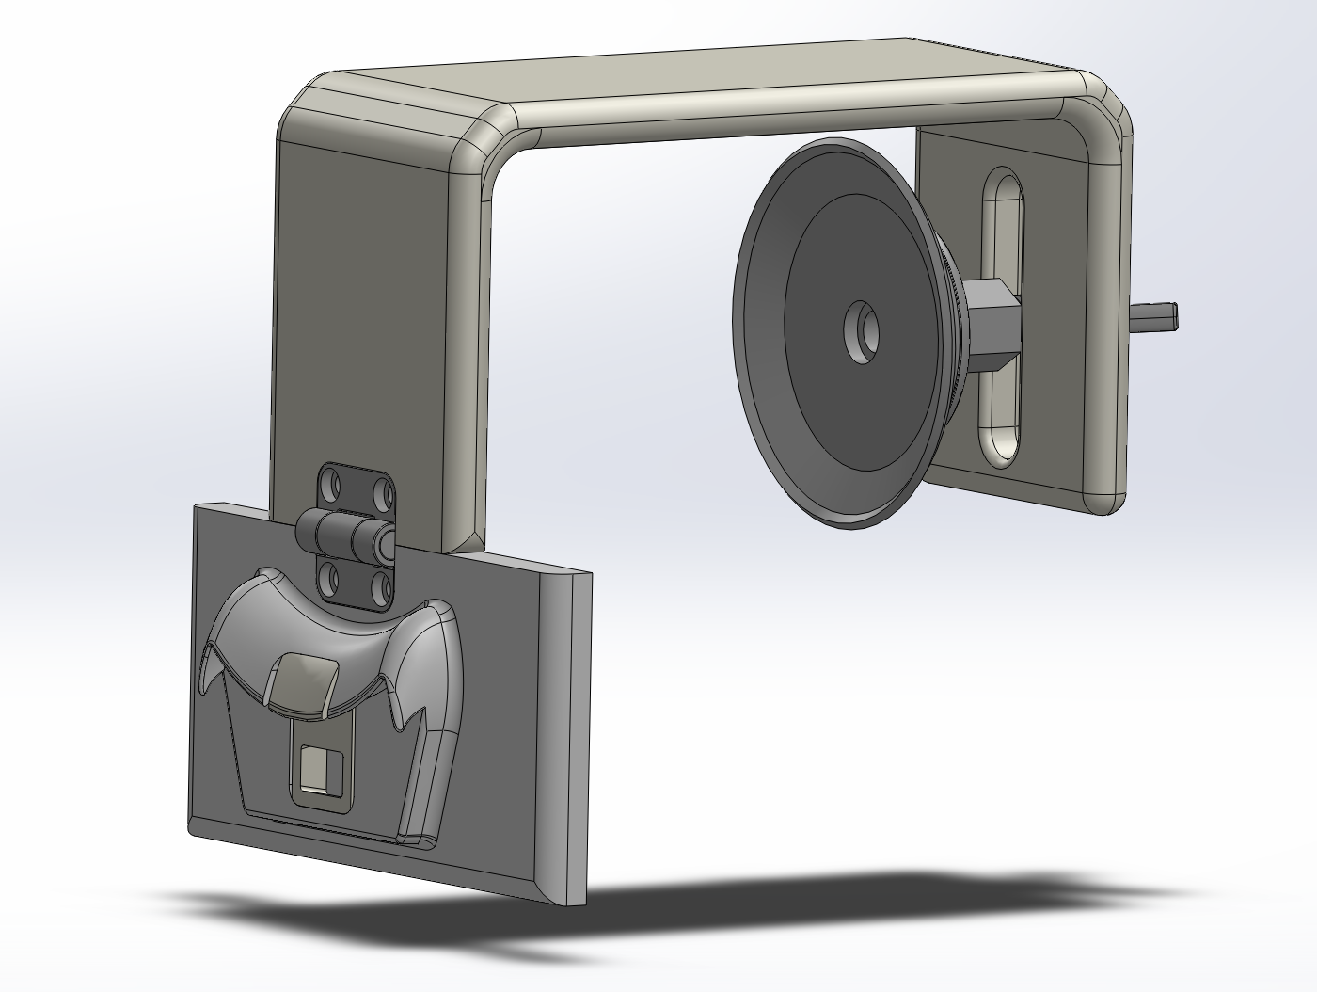

Slide 12
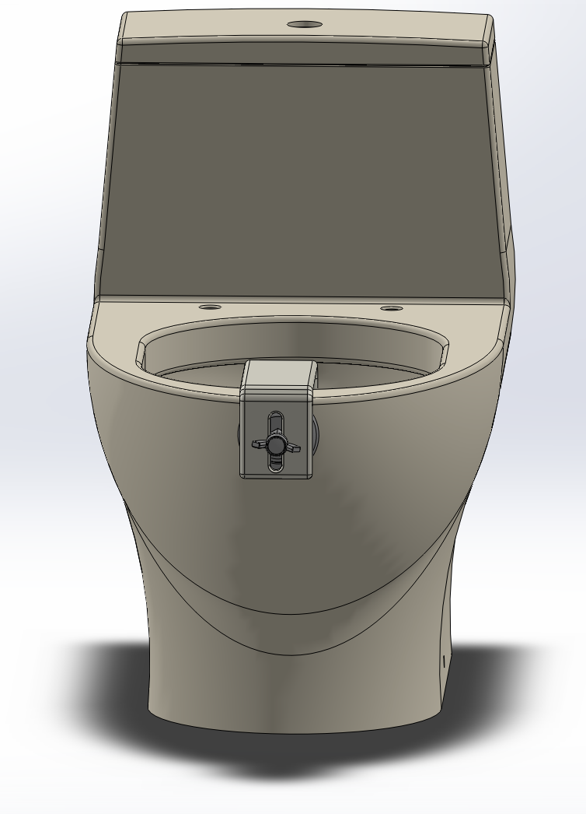
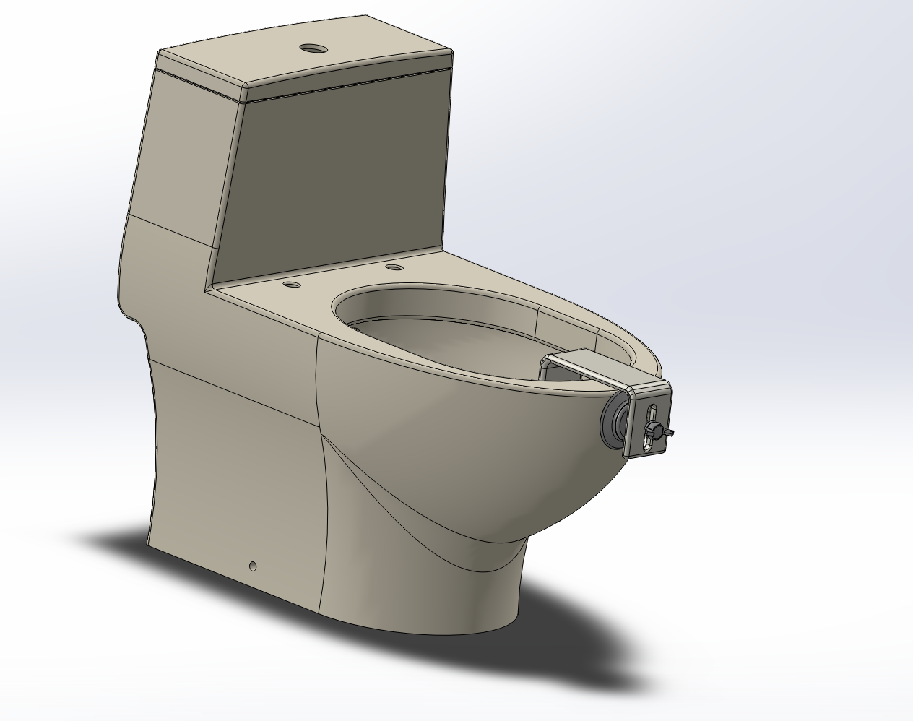

Slide 13
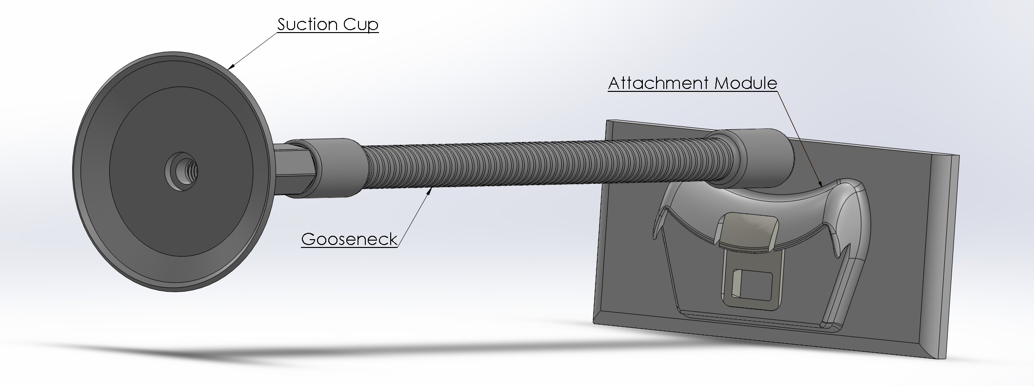
Suction Cup (Outside of Bowl) V2

Slide 14
Bill of Materials
Item | Quantity | Unit Cost
Suction Cup | 1 | $28.03
Flexible Gooseneck | 1 | $40.54
VytaFlex 20 | 1 | $4.01
Total |  | $72.58

Slide 15
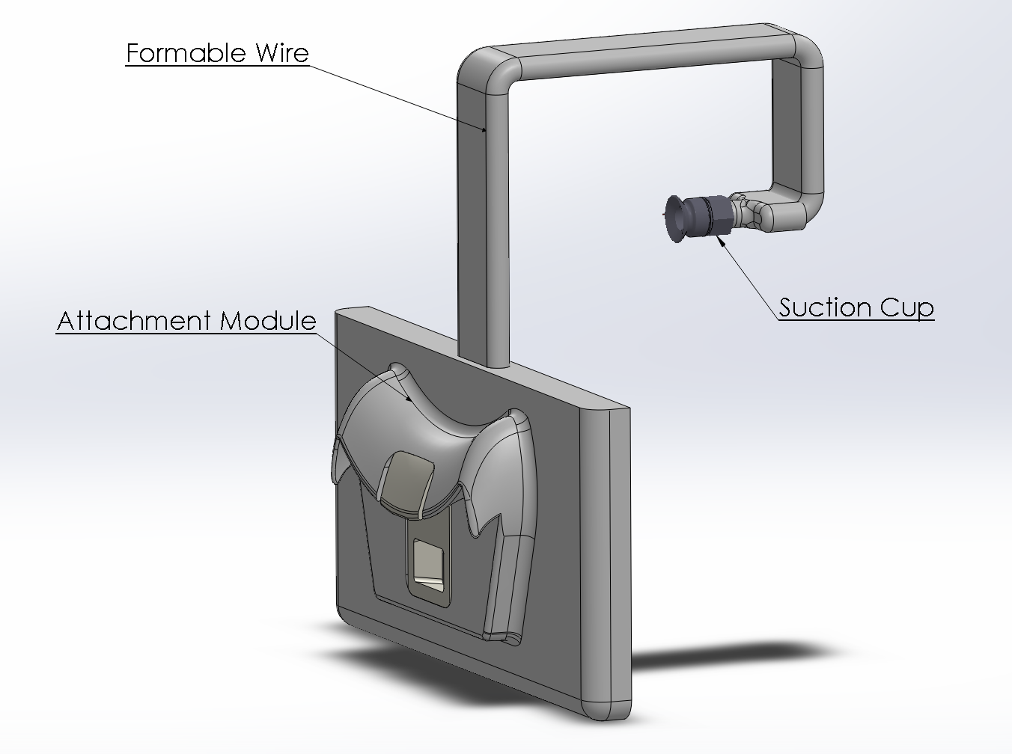
Suction Cup (Outside of Bowl) V3

Slide 16
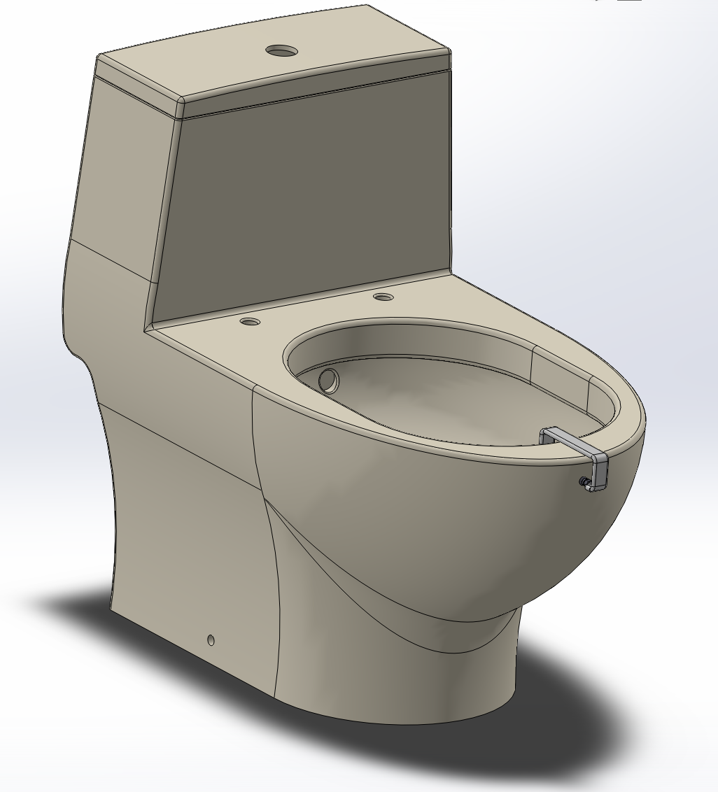
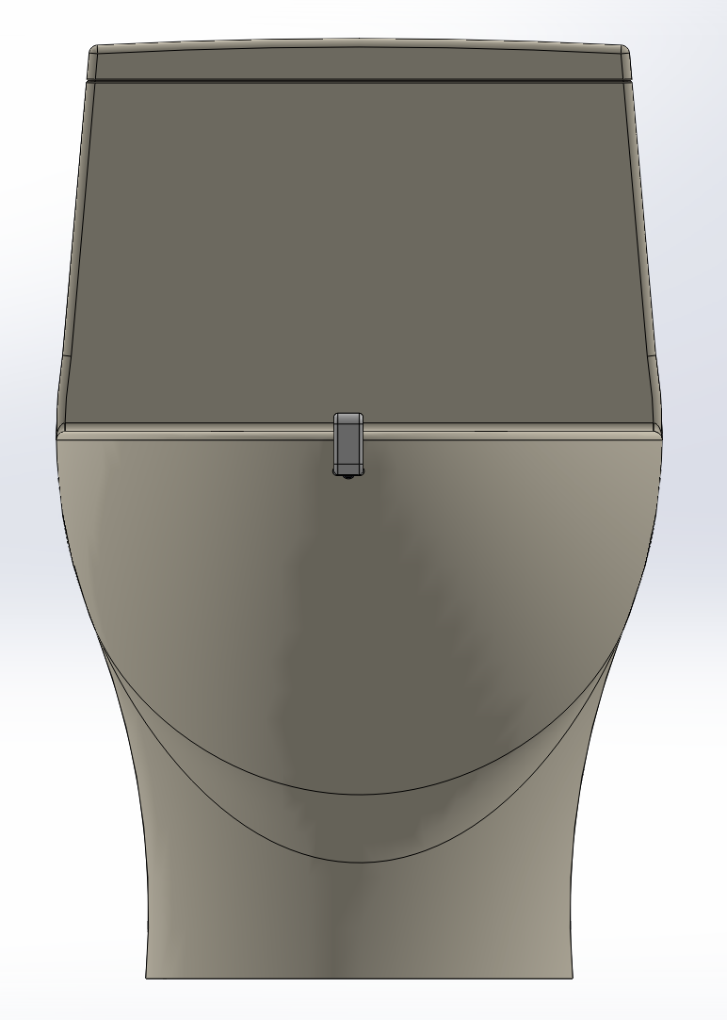

Slide 17
Bill of Materials
Item | Quantity | Unit Cost
Suction Cup | 1 | $11.37
Aluminum Wire | 1 | $4.52
VytaFlex 30 | 1 | $1.36
Total |  | $18.50

Slide 18
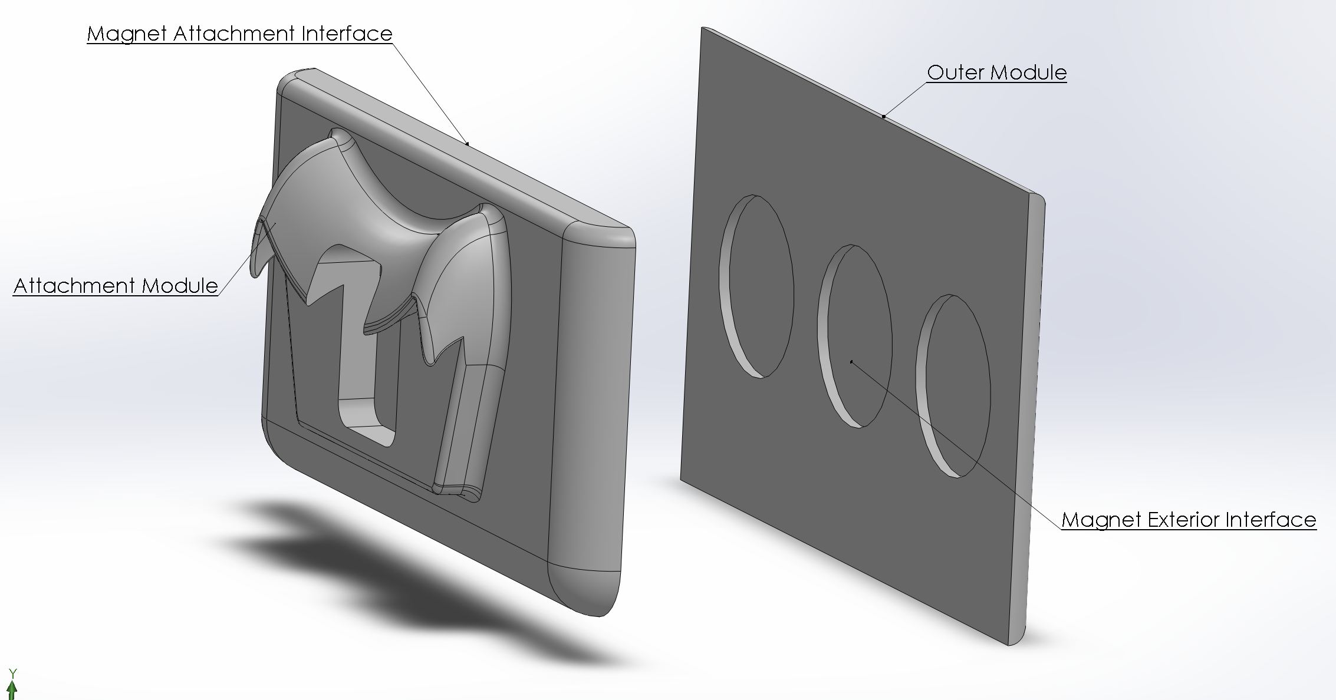
Magnetic Attachment

Slide 19
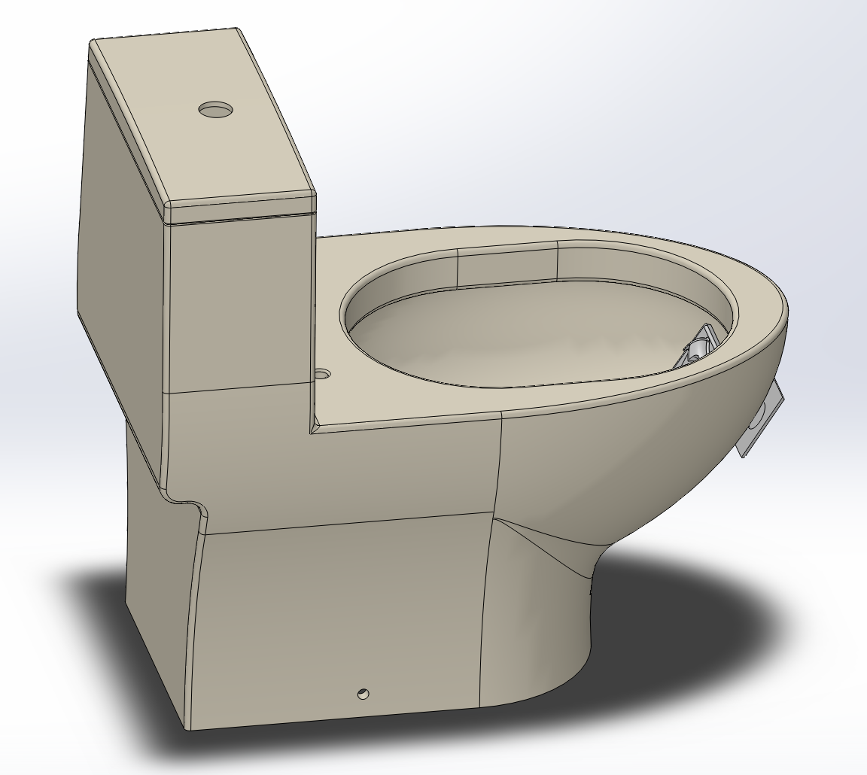
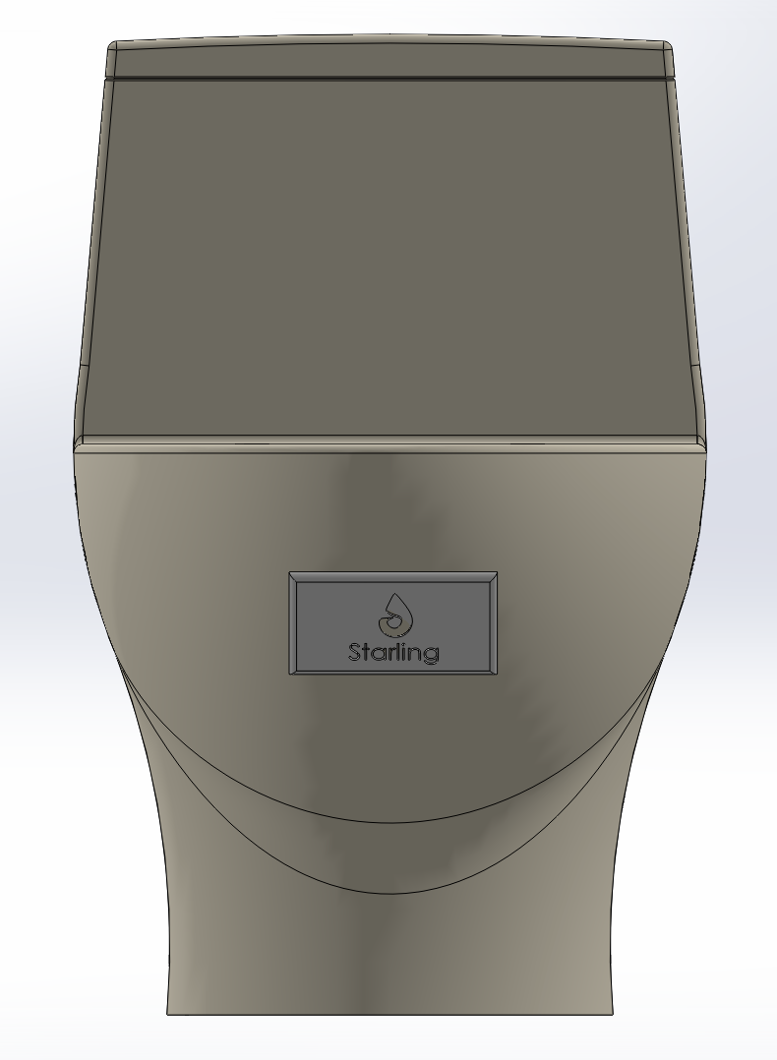

Slide 20
Final Selection
Overview of Concepts

Slide 21
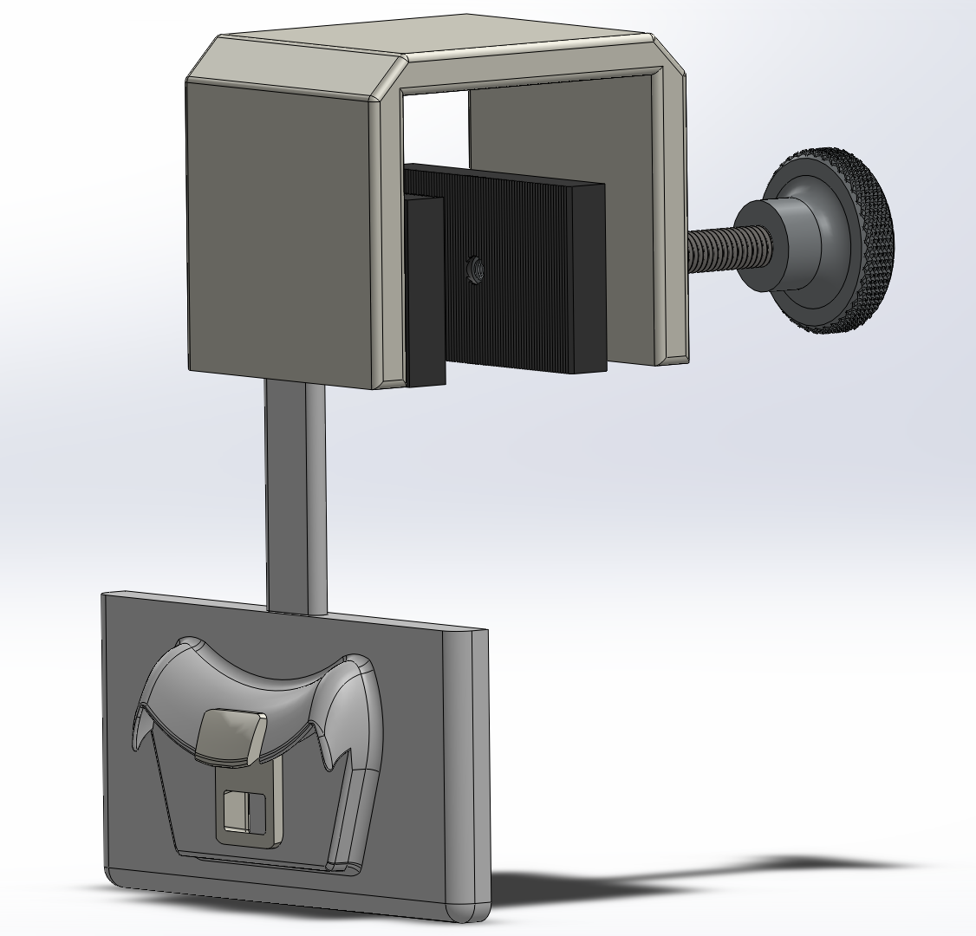
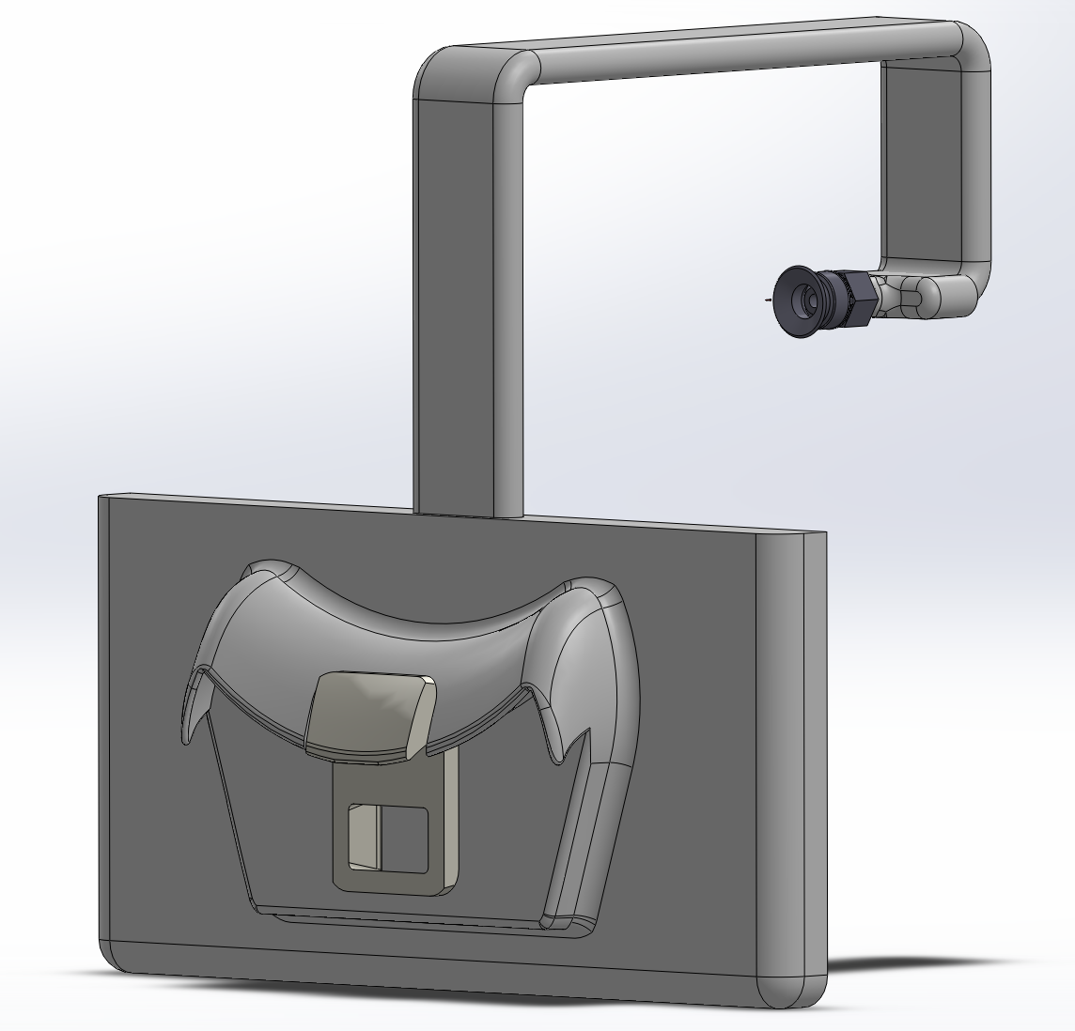
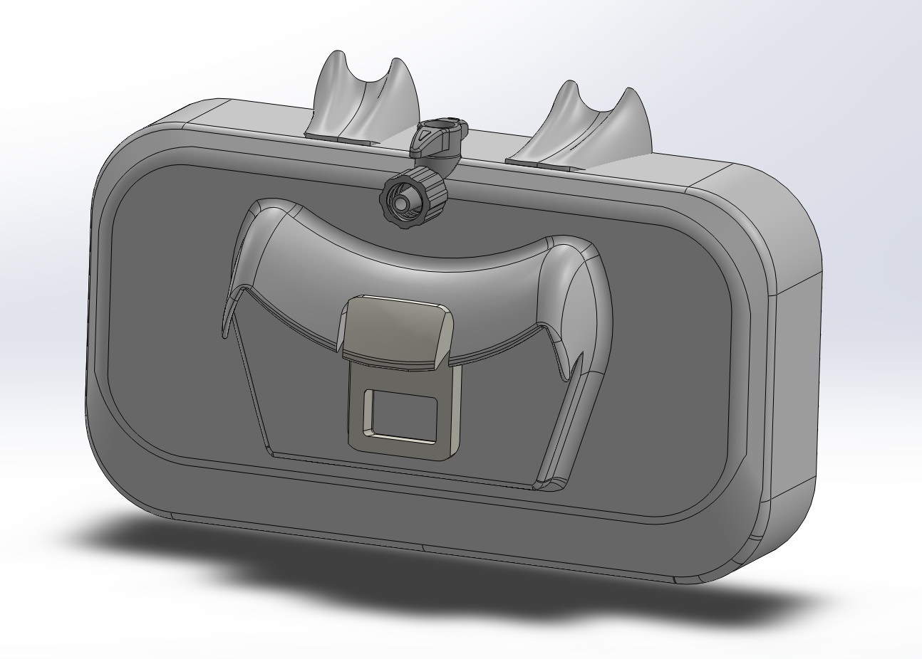
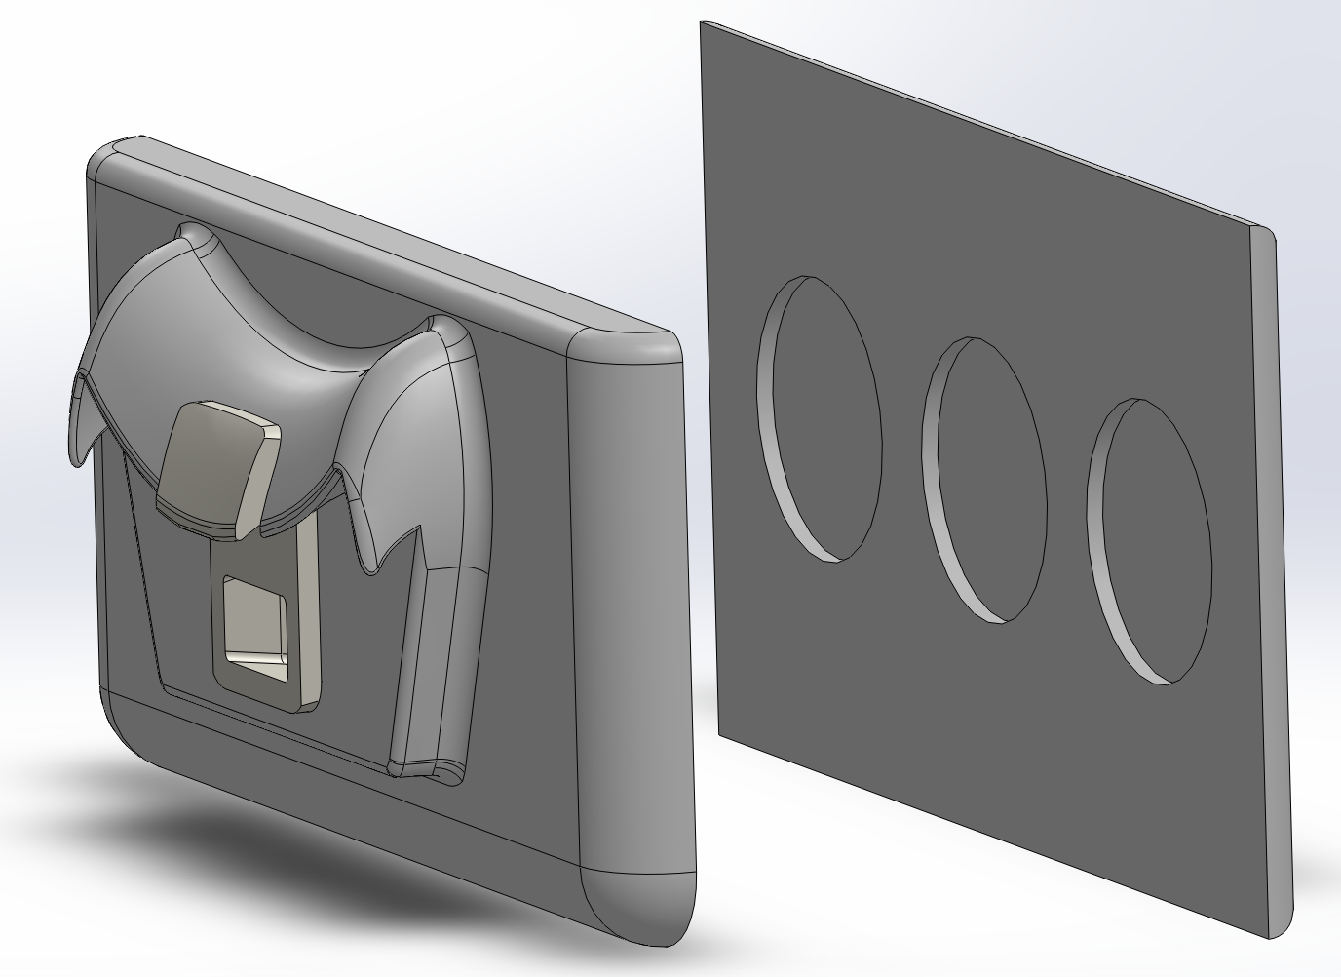
Mechanical Clamp Design
Scorpion Design
Interior Suction Cup Design
Magnetic Attachment Design

Slide 22
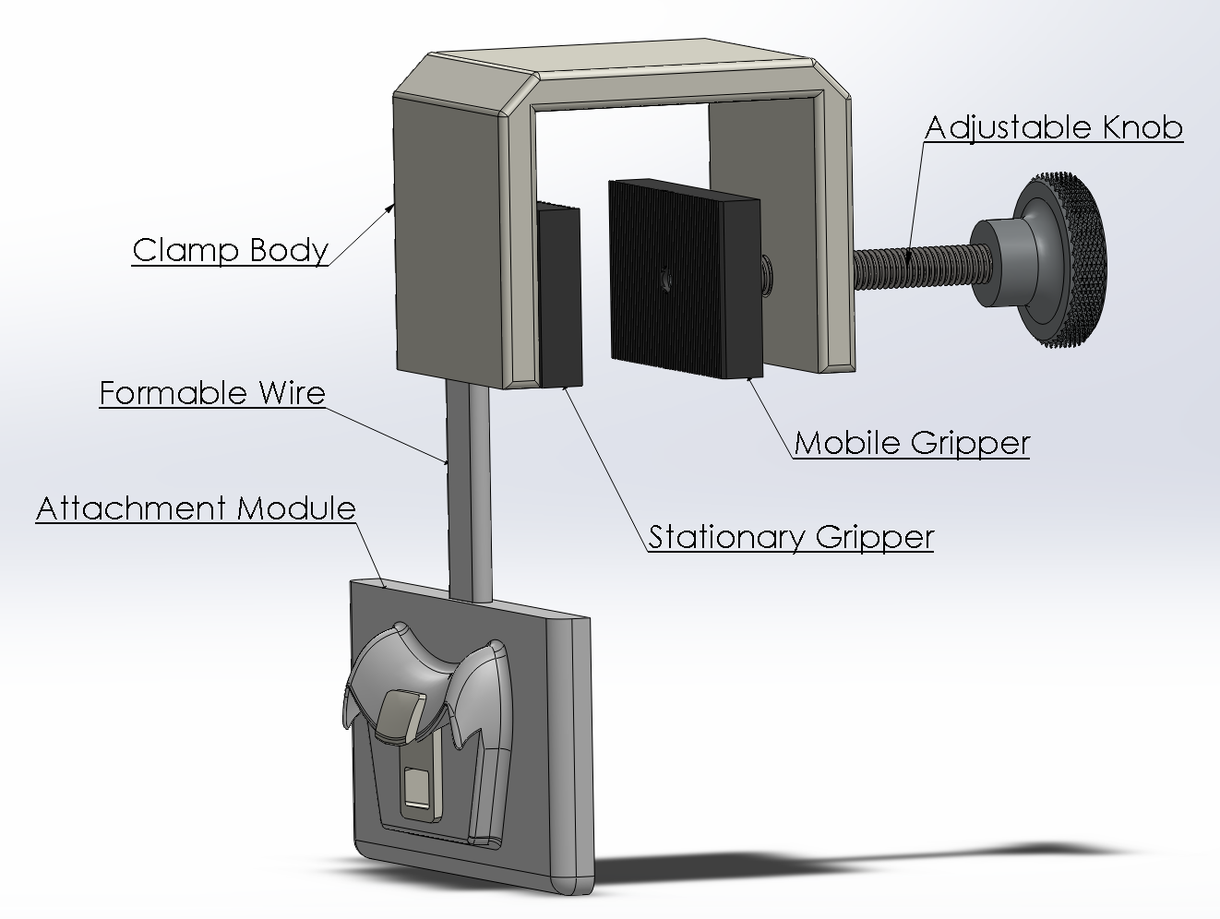
Mechanical Clamp
Item | Unit Cost
Knob | $9.44
Wire | $0.09
PMC-790 (Grippers) | $2.38
VytaFlex 30 (Attachment Module + Wire Exterior) | $2.83
Task 21 (Connector) | $0.27
Total | $15.01

Slide 23
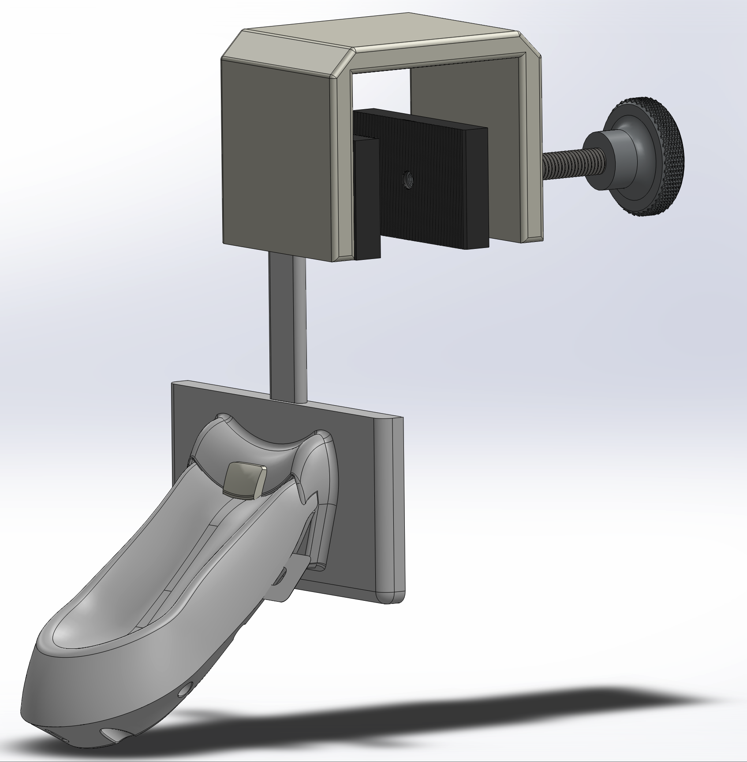
Mechanical Clamp

Slide 24
Scorpion Design
Item | Unit Cost
Suction Cup | $11.37
Wire | $3.70
VytaFlex 30 (Attachment Module + Wire Exterior) | $2.72
Task 21 (Connector) | $0.27
Total | $18.06

Slide 25
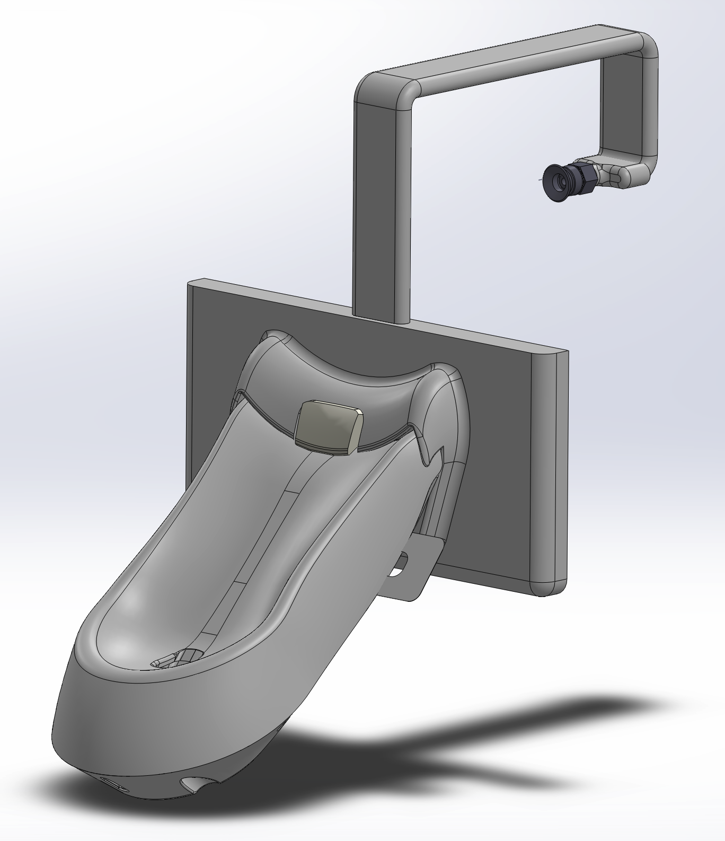
Scorpion Design

Slide 26
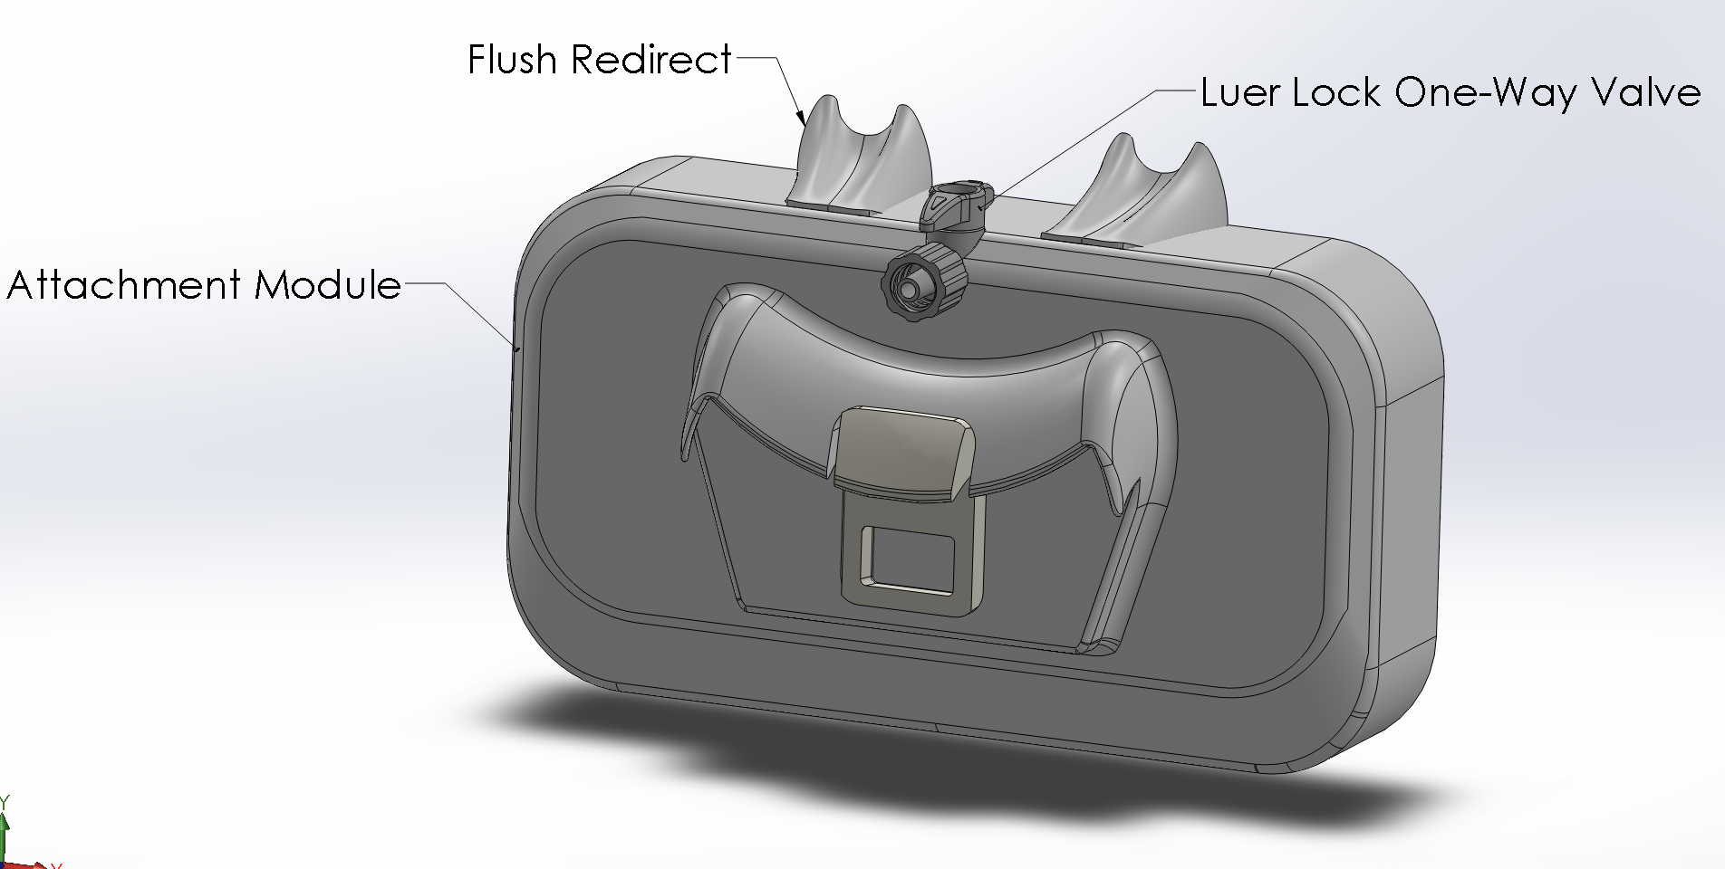
Suction Cup Interior Design
Item | Unit Cost
Luer Lock | $2.66
VytaFlex 30 (Attachment Module) | $2.37
Task 21 (Connector) | $0.27
Total | $5.65

Slide 27
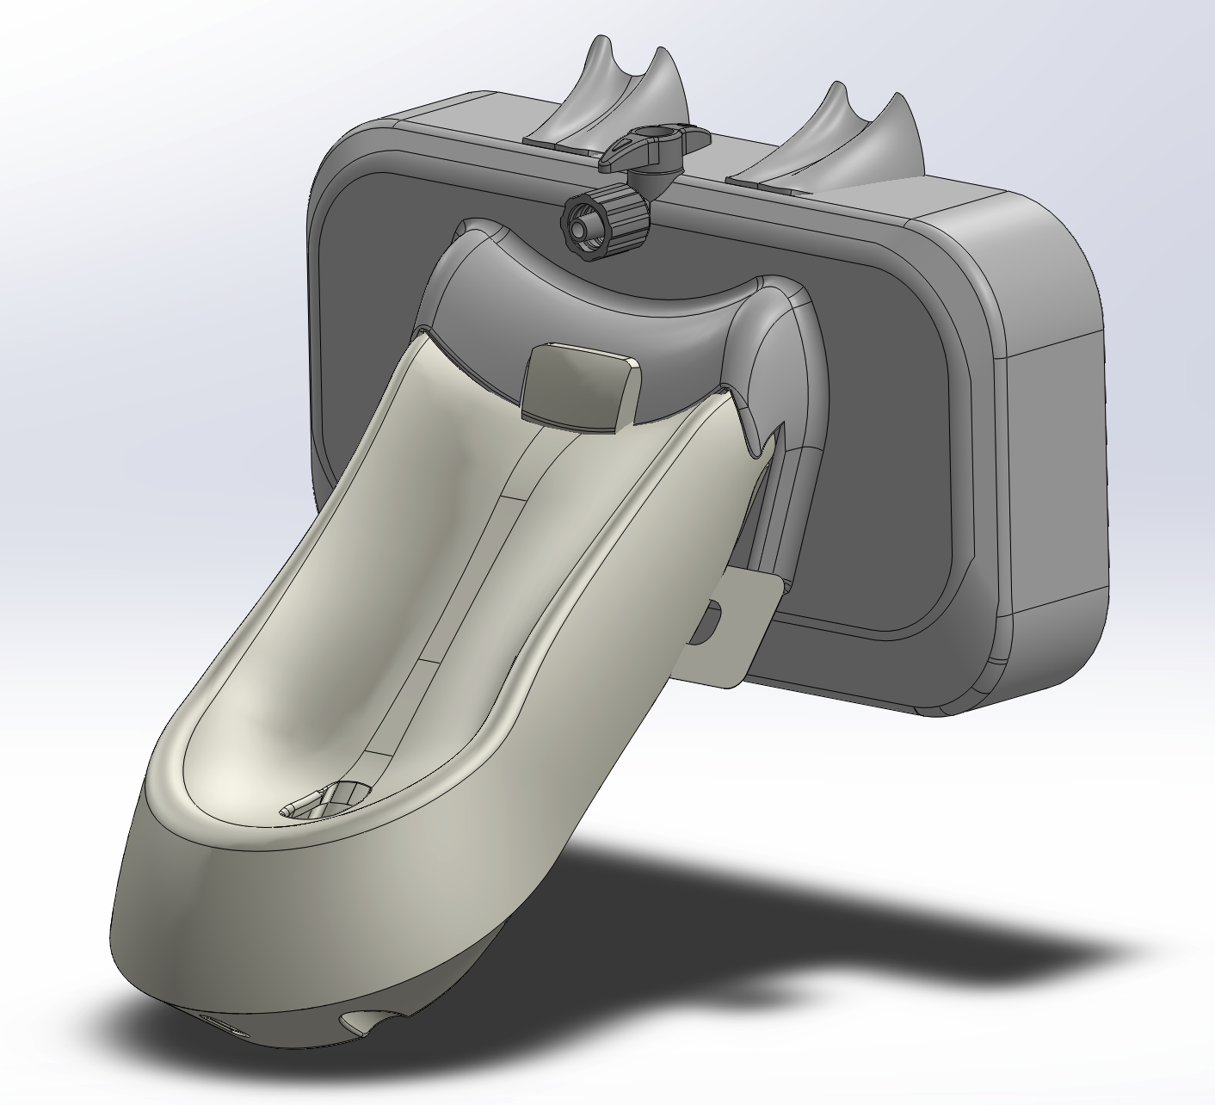
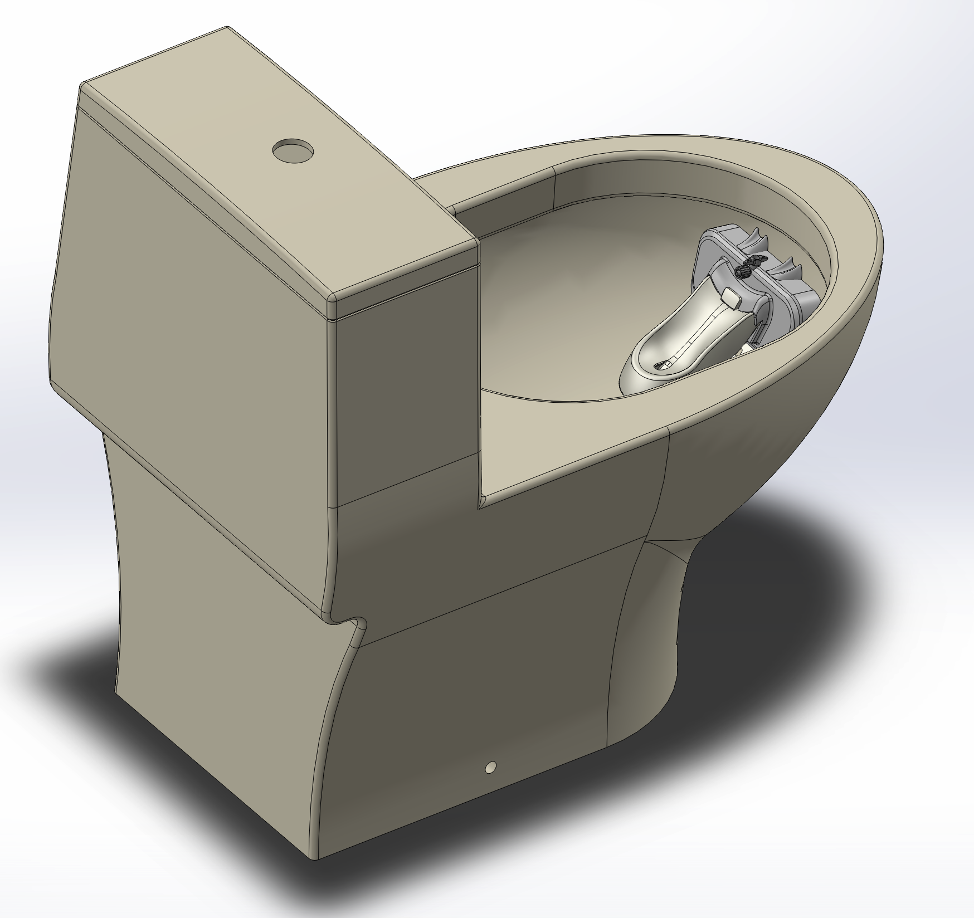
Suction Cup Interior Design

Slide 28
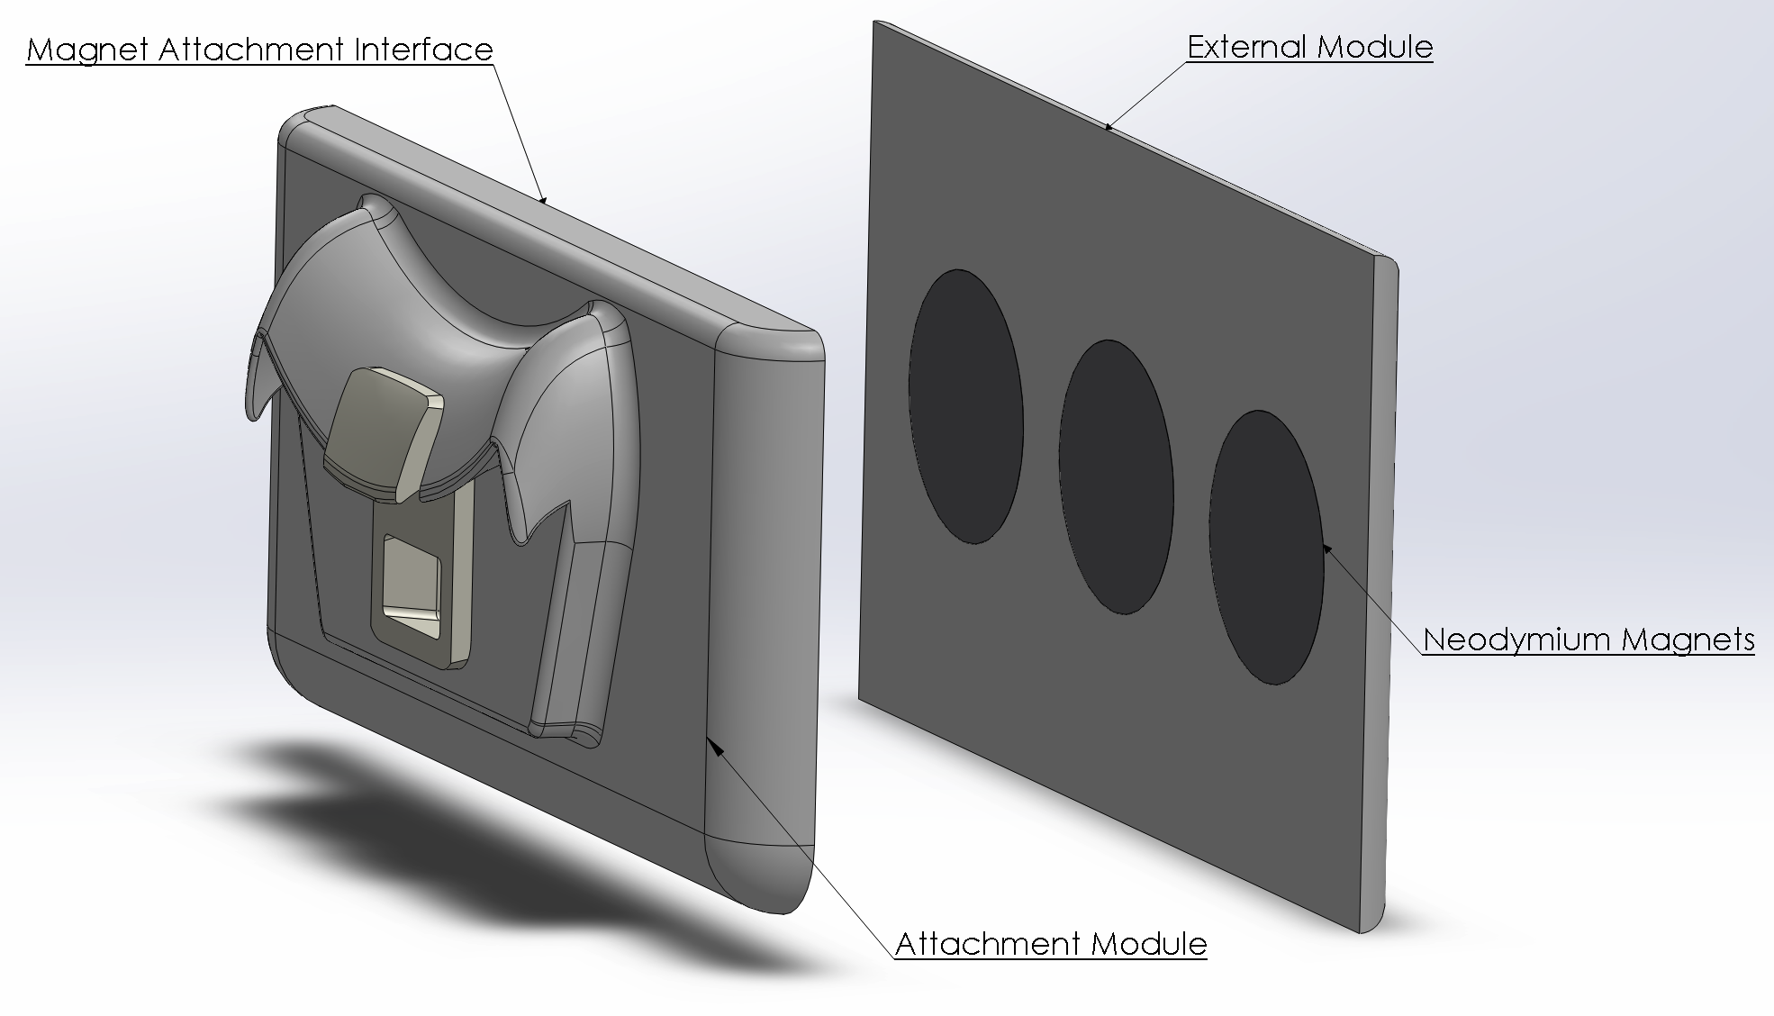
Magnetic Attachment Design
Item | Unit Cost
Magnets | $5.70
VytaFlex 30 (Soft Casing) | $8.58
Task 21 (Connector) | $0.27
Total | $14.55

Slide 29
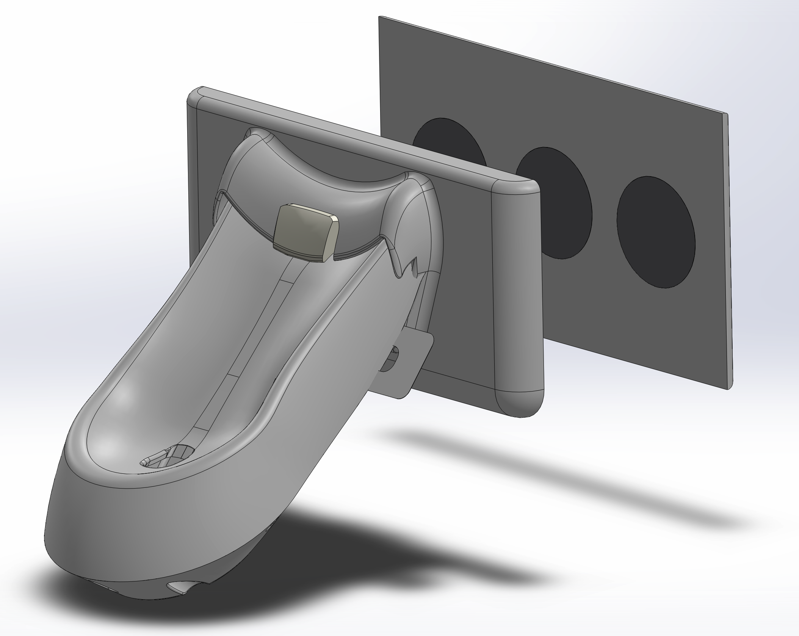
Magnetic Attachment Design

